Slide 1
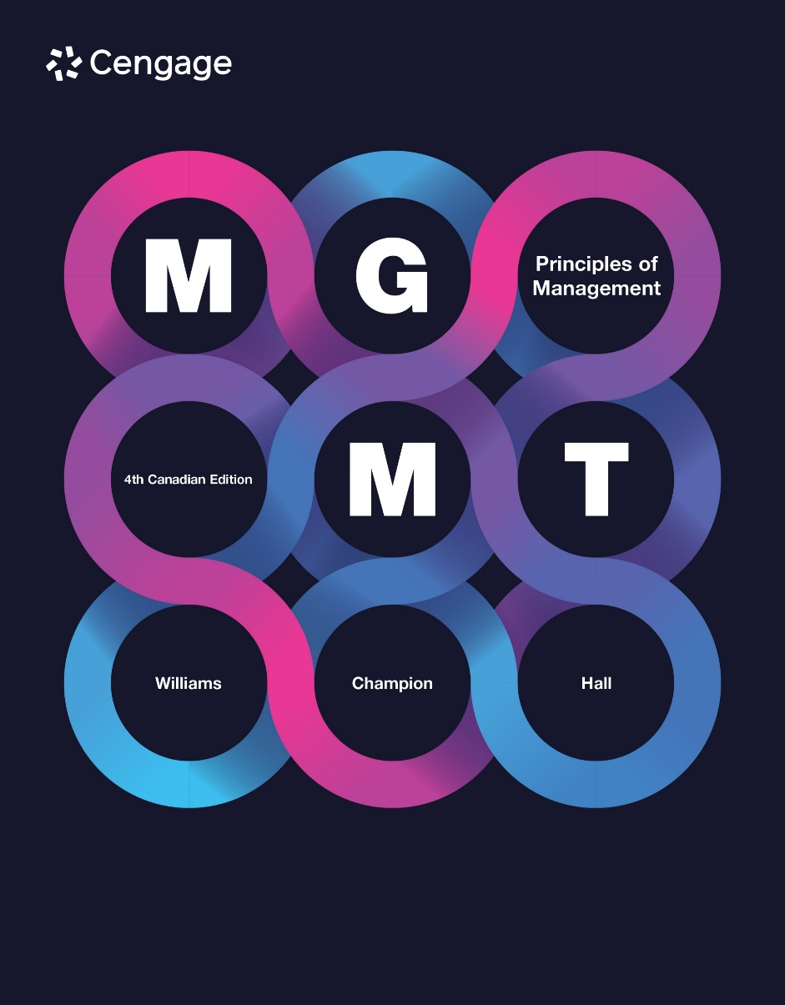

Slide 2
Chapter 10
Human Resource Management
Lecture Week Twelve
20 Mar 25
Dr Ike

Slide 3
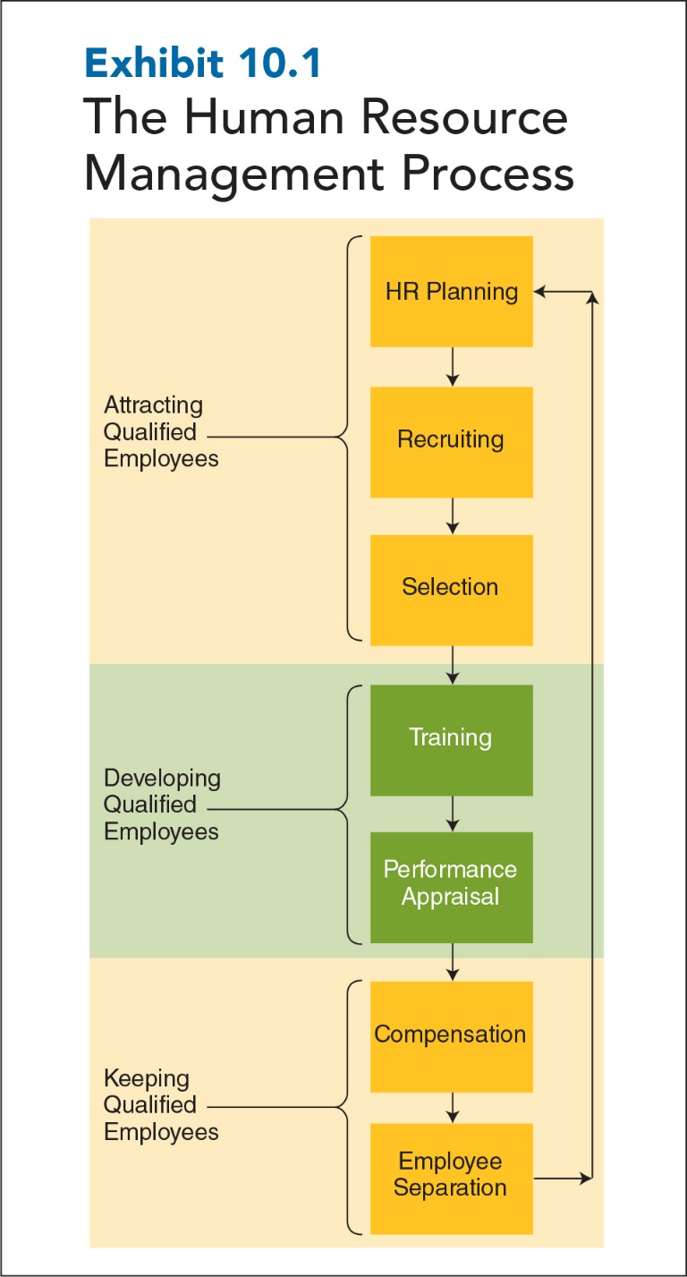
10-3
Notes:
Human resource management: the process of attracting, developing, and keeping qualified employees—which remains one of most important and difficult of management tasks.
Human resource process components are interdependent issues. You can’t solve one problem without considering the impact on others. The exhibit shows how human resource needs affect how a company uses recruiting and selection to attract employees. The kind and number of employees hired influence the orientation, training, performance appraisal, and compensation strategies a company uses, which in turn affect who stays and who leaves. As indicated by the feedback loop, the process comes full circle as the number and kind of employees who leave a company affect its human resource needs and planning.

Slide 4
Employment Legislation: What Is It All About?
Federal and provincial legislation
Covers human rights and employment standards
Labour relations, health and safety, and employment equity
The Canadian Labour Code
The Constitution Act of 1867 (formerly known as the British North America Act)
The Canadian Charter of Rights and Freedoms (1982)
4
10-4
Notes:
Canada’s employment laws rest primarily with the provinces and territories. The federal government has laws that quite often mirror those of the provinces, but human rights, employment standards, labour relations, health and safety, employment equity, and other employment-related legislation belongs to the ten provinces and three territories. Canada’s legal system is based on both British and French colonial law. The Constitution Act of 1867 (formerly known as the British North America Act) laid the foundation for our systems today. Part I of the Canadian Labour Code sets out industrial relations (bargaining rights, strikes, union certifications); Part II sets out occupational health and safety guidelines; Part III sets out standards for hours, wages, vacations, and holidays.
Pay equity (equal pay for work of equal value) is another area addressed by employment standards acts. An employer cannot pay women differently if they are performing the same work as men, and work of equal value must be equally paid as well.

Slide 5
Summary of Major Federal Employment Laws
Constitution Act (BNA) of 1867 | Sets out basic federal and provincial responsibilities
Canadian Charter of Rights and Freedoms | Sets out the 15 basic areas of freedoms in Canada
Canadian Human Rights Act | Prohibits discrimination on a number of grounds
10-5

Slide 6
Summary of Major Federal Employment Laws
Canadian Labour Code | Lays out responsibilities of each province and provides national guidelines
Employment Equity and Pay Equity Legislation | Requires equal pay for work of equal value
Workers Compensation Act (Manitoba) | Provincial act that lays out safety standards
10-6
Notes:
Note that these laws apply to the entire HRM process and not just to selection decisions (i.e., hiring and promotion). Thus, these laws also cover all training and development activities, performance appraisals, terminations, and compensation decisions. Employers who use gender, age, race, or religion to make employment-related decisions when those factors are unrelated to an applicant’s or employee’s ability to perform a job may face charges of discrimination before human rights tribunals, as well as employee lawsuits.

Slide 7
Employment Discrimination and BFOQ
BFOQ: Bona Fide Occupational Qualification
An exception in employment law that permits sex, age, religion, and the like to be used when making employment decisions, only if they are “reasonably necessary to the normal operation of that particular business.”
10-7
Notes:
For example, if Victoria’s Secret hires models for its women's swimwear line, it probably won’t be taken to task for hiring women, as being female would be seen as a BFOQ for being a women’s swimwear model.

Slide 8
Employment Discrimination and BFOQ
Unfair discrimination
Intentional or unintentional
Often based on race, religion, or ethnic origin
Falls under the Charter of Rights and Freedoms
Leads to investigations by one of the provincial or territorial Human Rights Commissions
10-8

Slide 9
Canadian Human Rights Commission
Guide to Understanding the Canadian Human Rights Act:
Canadian Human Rights Commission
Duty to Accommodate/Undue Hardship:
Canadian Human Rights Commission
10-9
Notes:
The Canadian Human Rights Commission offers a wealth of information, fact sheets, examples, past cases, and video clips.
Have students visit these links:
http://www.chuman resourcec-ccdp.ca/eng/content/your-guide-understanding-canadian-human-rights-act-page1
http://www.chuman resourcec-ccdp.ca/eng/content/duty-accommodate
The latter link provides the duty of an employer or service provider to accommodate groups or individuals by eliminating “different and negative treatment…based on prohibited grounds of discrimination.”

Slide 10
Workplace Harassment
Workplace harassment:
Prohibited by several laws, both federal and provincial
Does not have to be sexual in nature, although it commonly is
Harassment can also mean that someone is bullying you about your work or tormenting you simply because you are a man or a woman.
Expressing stereotypes about one gender, for example, can be a form of harassment.
10-10
Notes:
In some provinces, cases are handled by a Human Rights Commission; in other provinces, cases are handled by a Human Rights Tribunal. Most of the cases involve infractions of the Labour Code and are dealt with under the Human Rights Act. Individuals and employers deal with issues through civil courts.
Alpaerts v. Obront was one case that had limited success in challenging the exclusive remedial jurisdiction of the Labour Code. The plaintiff alleged sexual harassment in her workplace to the point of constructive dismissal (i.e., intolerable circumstances). She sued for wrongful dismissal, alleging in part human rights violations by the employer. The case was allowed to proceed, partly on the basis that the plaintiff had a cause of action separate from the code violation. The court was concerned that if a code complaint had been brought at the same time, the result could have been different and a stay might have been merited. None of the provinces—or, for that matter, the Canadian Human Rights Commission—will investigate without the formal filing of a complaint.

Slide 11

Sexual Harassment
Sexual harassment: a form of discrimination in which unwelcome sexual advances, requests for sexual favours, or other verbal or physical conduct of a sexual nature occurs while performing one’s job.
Another form of sexual harassment is when employment outcomes, such as hiring, promotion, or simply keeping one’s job, depend on whether an individual submits to sexual harassment.
10-11
Notes:
Sexual harassment: A form of discrimination in which unwelcome sexual advances, requests for sexual favours, or other verbal or physical conduct of a sexual nature occur while performing one’s job; another form of sexual harassment is when employment outcomes, such as hiring, promotion, or simply keeping one’s job, depend on whether an individual submits to sexual harassment.
A hostile work environment occurs when unwelcome and demeaning behaviour creates an intimidating, hostile, and offensive work environment.
One province defines harassment as “engaging in a course of vexatious comment or conduct against a worker in a workplace that is known or ought reasonably to be known as unwelcome” (vexatious generally is taken as action that is distressing... full of disorder or stress). In Quebec, the first province to prohibit “psychological harassment” at work, the Labour Standards Tribunal listed some examples of bullying: “rude, degrading or offensive remarks, spreading rumours, ridicule, shouting abuse, belittling employees, ignoring them or making fun of their personal choices.” Harassment has been endemic in some Canadian organizations, such as the RCMP, and it will take concerted efforts of today’s managers as well as future managers (the students reading the textbook) to make Canada a harassment-free place to work.

Slide 12
Sexual Harassment: What Companies Should Do
Respond immediately to reports.
Engage in a quick and fair investigation.
Create a sexual harassment policy.
Communicate this policy (zero tolerance).
Establish clear reporting procedures.
Provide an impartial, nonthreatening avenue for employees to access.
Be aware of federal, provincial, and municipal laws.
10-12

Slide 13
Human Resource Planning
Human resource planning: an umbrella term that encompasses overarching philosophies, policies, and practices that are in line with the organization’s strategy.
10-15
Notes:
Human resource planning ensures that the organization has the appropriate human resources to implement its chosen strategy, that all parts of the HR function embrace the chosen strategy, and that the other functional departments (finance, manufacturing, marketing, etc.) have the human resources they need to accomplish their own strategic objectives.
Example: If the organization has adopted a strategy of customer service, then the HR department must ensure that its policies, processes, and actions will help the organization realize that chosen “customer service” strategy. HR planning ensures that all parts of the HR function embrace the chosen strategy and ensures that the other functional departments (finance, manufacturing, marketing, etc.) have the human resources they need to accomplish their own strategic “customer service” objectives.

Slide 14
Recruiting
Recruiting is the process of developing a pool of qualified job applicants.
Job Analysis
and
Recruiting
Internal Recruiting
External Recruiting
14
10-14

Slide 15
Job Analysis and Recruiting
Job Analysis
A purposeful, systematic process for collecting information on the important work-related aspects of a job
Job Description
A written description of the basic tasks, duties, and responsibilities required of an employee holding a particular job
Job Specifications
A written summary of the qualifications needed to successfully perform a job
10-15
Notes:
Job analyses, job descriptions, and job specifications are the foundation on which all critical human resource activities are built.
Information derived from job analysis is vital to effective human resource planning. Job analysis collects four kinds of information:
Work activities, such as what workers do and how, when, and why they do it
Tools and equipment used to do a job
Context in which the job is performed, such as actual working conditions and schedule
Personnel requirements for performing the job, meaning the knowledge, skills, and abilities needed to do the job well
Tools: Job analysis information can be collected by having job incumbents and/or supervisors complete questionnaires, by direct observation, by interviews, or by filming employees as they perform their jobs. Job descriptions and job specifications are two of the most important results of job analysis.
Job analyses, job descriptions, and job specifications also help companies meet the legal requirement that their human resource decisions be job-related. To be judged job-related, recruitment, selection, training, performance appraisals, and employee separations must be valid and be directly related to the important aspects of the job as identified by a careful job analysis.

Slide 16
Internal and External Recruiting
Internal Recruitment
“Promotion from within” or "lateral transfers"
Improves employee morale and motivation
Reduces start-up time and costs
Job posting and career paths are two methods of internal recruiting
Succession planning
10-16
Notes:
Internal recruiting (a.k.a., “promotion from within”): the process of developing a pool of qualified job applicants from people who already work in the company. It improves employee commitment, morale, and motivation. Recruiting current employees reduces recruitment start-up time and costs; and because employees are already familiar with the company’s culture and procedures, they are more likely to succeed in their new jobs.
Methods – Job posting and career paths are two methods of internal recruiting.
Job posting: the procedure for advertising job openings within a company to existing employees. The job description and requirements are typically posted on a bulletin board, in a company newsletter, or in an internal computerized job bank accessible only to employees. Job posting helps organizations discover hidden talent, allows employees to take responsibility for career planning, and makes it easier for companies to retain talented workers who are dissatisfied in their current jobs and would otherwise leave the company. In fact, a LinkedIn survey of workers who changed jobs found that 42 percent would have stayed with their former employers if a relevant position had been available.
Career path: the planned sequence of jobs through which employees may advance within in an organization. For example, the person who starts as a sales representative may move up to sales manager, then to district/regional sales manager. Career paths help employees focus on long-term goals and development while helping companies do succession planning.
Succession planning: evaluating the staffing that will be required in future years to replace people who retire, or who may leave, and to provide personnel for needed strategic growth requirements.

Slide 17
Internal and External Recruiting
External Recruitment
Advertising
Employee referrals
Walk-ins
Outside organizations
Employment services
Special events
Internet job sites
10-17
Notes:
External recruiting: the process of developing a pool of qualified job applicants from outside a company. External recruitment methods include advertising (newspapers, magazines, direct mail, radio, television), employee referrals (asking current employees to recommend possible job applicants), walk-ins (people who apply on their own), outside organizations (universities, technical/trade schools, professional societies), employment services (state/ private employment agencies, temporary agencies, and professional search firms), special events (career conferences/ job fairs), and Internet job sites.
Which external recruiting method should you use?
Studies show that employee referrals, walk-ins, newspaper advertisements, and employment agencies tend to be used most frequently for office/clerical and production/service employees. Newspaper advertisements and college/university recruiting are used most frequently for professional/technical employees. When recruiting managers, organizations tend to rely heavily on newspaper advertisements, employee referrals, and search firms.
Realistic job previews: a tool used to explain to potential new employees both the positive and negative aspects of a new job; ensures that new applicants are provided with sufficient information to arrive at an informed decision. They provide information about pay and hours of work, but they also discuss aspects of the job such as promotion rates, job progression, amount of flexibility, self-autonomy, stress, interaction with customers, amount of travel, and the corporate culture.

Slide 18
Selection
Application Forms and Résumés
References and Background Checks
Selection Tests
Interviews
10-18
Notes:
Selection: the process of gathering information about job applicants to decide who should be offered the job
Validation: the process of determining how well a selection test or procedure predicts future job performance. The better or more accurate the prediction of future job performance, the more valid a test is said to be.
Although an application form often asks for information already provided by the résumé (such as the applicant’s name, address, and job and educational history), most organizations prefer to collect this information in their own format (i.e., the application form) for entry into a human resource information system (HRIS).
Employment-related laws apply to application forms just as they do all selection devices. Application forms may ask applicants about valid, job-related information. However, application forms commonly ask applicants to report non-job-related information such as marital status, maiden name, age, date of high school graduation. (See various websites, such as the Alberta Human Rights Commission website, www.albertahumanrights.ab.ca, for information on pre-employment questions.) There is quite a bit of information that companies are not permitted to request in application forms, during job interviews, or in any other part of the selection process. Courts will assume that you consider all of the information you request of applicants, even if you don’t. So be sure to ask only those questions that directly relate to the candidate’s ability and motivation to perform the job.
Résumés pose problems for companies but in a different way. Studies have found that as many as one-third of job applicants intentionally falsify some information on their résumés and that 80 percent of the information on résumés may be misleading. Therefore, managers should verify the information collected via résumés and application forms by comparing it with additional information collected during interviews and other stages of the selection process, such as references and background checks.

Slide 19
References and Background Checks
Background checks verify the truthfulness and accuracy of information that applicants provide about themselves.
Many previous employers are increasingly reluctant to provide references or background check information.
Many companies are starting to perform social media background checks (e.g., Facebook, Twitter).
10-19
Notes:
According to the Society for Human Resource Management, 96 percent of companies conduct background checks and 80 percent conduct criminal record checks.
Employment references: sources such as previous employers or coworkers who can provide job-related information about job candidates
Background checks: procedures used to verify the truthfulness and accuracy of information that applicants provide about themselves and to uncover negative, job-related background information not provided by applicants.
Background checks are conducted by contacting “educational institutions, prior employers, court records, police and governmental agencies, and other informational sources either by telephone, mail, remote computer access, or through in-person investigations.”
Previous employers are increasingly reluctant to provide references/ background check information for fear of being sued by previous employees for defamation. If former employers provide unsubstantiated information to potential employers that damages the applicant’s chances of being hired, applicants can and do sue for defamation. Many employers provide only dates of employment, positions held, and date of separation.
(Source: Statistics in the slide provided by the Society for Human Resource Management.)

Slide 20
Selection Tests
Selection tests
Specific ability
Cognitive ability
Biographical data
Personality
Work sample (also called performance tests)
Assessment centres
10-20
Notes:
Selection tests give organizational decision makers a chance to know who will, and won’t, likely do well in a job.
Specific ability tests measure the extent to which an applicant possesses a particular kind of ability needed to do a job well. Specific ability tests are also called aptitude tests because they measure aptitude for doing a particular task well.
Cognitive ability tests measure the extent to which applicants have abilities in perceptual speed, verbal comprehension, numerical aptitude, general reasoning, and spatial aptitude. These tests indicate how quickly and how well people understand words, numbers, logic, and spatial dimensions. Specific ability tests predict job performance only in particular types of jobs; cognitive ability tests accurately predict job performance in almost all kinds of jobs.
Biographical data/biodata are extensive surveys that ask applicants questions about their personal background and life experiences. The basic idea behind biodata is that past behaviour (personal background and life experience) is the best predictor of future behaviour.
Personality tests measure the extent to which applicants possess different job-related personality dimensions.
Work sample tests, a.k.a. performance tests, require applicants to perform tasks that are done on the job. Unlike specific ability, cognitive ability, biographical data, and personality tests, work sample tests directly measure a job applicant’s capability to do the job.
Assessment centres use a series of job-specific simulations that are graded by multiple trained observers to determine the extent to which applicants can perform managerial work. Some of the more common assessment centre exercises are in-basket exercises, role plays, small-group presentations, and leaderless group discussions. An in-basket exercise is usually a computer-simulated test in which the applicant is given a manager’s in-basket containing emails, memos, phone messages, VoIP messages, organizational policies, and other communications normally received by and available to managers. Applicants explain how they would deal with each item. In a leaderless group discussion, a group of six applicants is given approximately two hours to solve a problem, but no one is put in charge (hence “leaderless”). Trained observers watch and score each participant on the extent to which he or she facilitates discussion, listens, leads, persuades, and works well with others.

Slide 21
Interviews
Unstructured interviews
Free flow of questions
Structured interviews
Interviewer uses standard set of prepared questions
Semi-structured interviews
Some structure combined with interviewer judgment
10-21
Notes:
Interviews: a selection tool in which company representatives ask job applicants job-related questions to determine whether they are qualified for the job.
Unstructured interviews: interviewers are free to ask applicants anything they want. Unstructured interviews work half as well as structured interviews in accurately predicting which job applicants should be hired.
Structured interviews: standardized interview questions prepared ahead of time, so applicants are asked the same job-related questions.
Semi-structured interviews: lie between structured and unstructured interviews. A major part of a semi‑structured interview (perhaps as much as 80 percent) is based on structured questions, but some time is set aside for unstructured interviewing to allow the interviewer to probe into ambiguous or missing information uncovered during the structured portion of the interview.
How well do interviews predict future job performance? Contrary to what you’ve probably heard, evidence shows that even unstructured interviews do a fairly good job. When conducted properly, structured interviews can lead to more accurate hiring decisions than can unstructured interviews. The validity of structured interviews can rival that of cognitive ability tests. Since interviews are especially good at assessing applicants’ interpersonal skills, they work well together with cognitive ability tests.

Slide 22
Questions in Structured Interviews
Situational Questions
Behavioural Questions
Background Questions
Job-Knowledge Questions
10-22
Notes:
Situational questions ask applicants how they would respond in a hypothetical situation (e.g., “What would you do if . . . ”). This type of question is more appropriate when hiring new graduates, who are unlikely to have encountered real-work situations because of their limited experience.
Behavioural questions ask applicants what they did in previous jobs that was similar to what is required for the job for which they are applying (e.g., “In your previous jobs, tell me about . . . ”). This type of question is more appropriate when hiring experienced individuals.
Background questions ask applicants about work experience, education, and other qualifications (e.g., “Tell me about the training you received at . . . ”).
Job knowledge questions ask applicants to demonstrate job knowledge (e.g., nurses, “Give me an example of a time when one of your patients had a severe reaction to medication. How did you handle it?”)

Slide 23
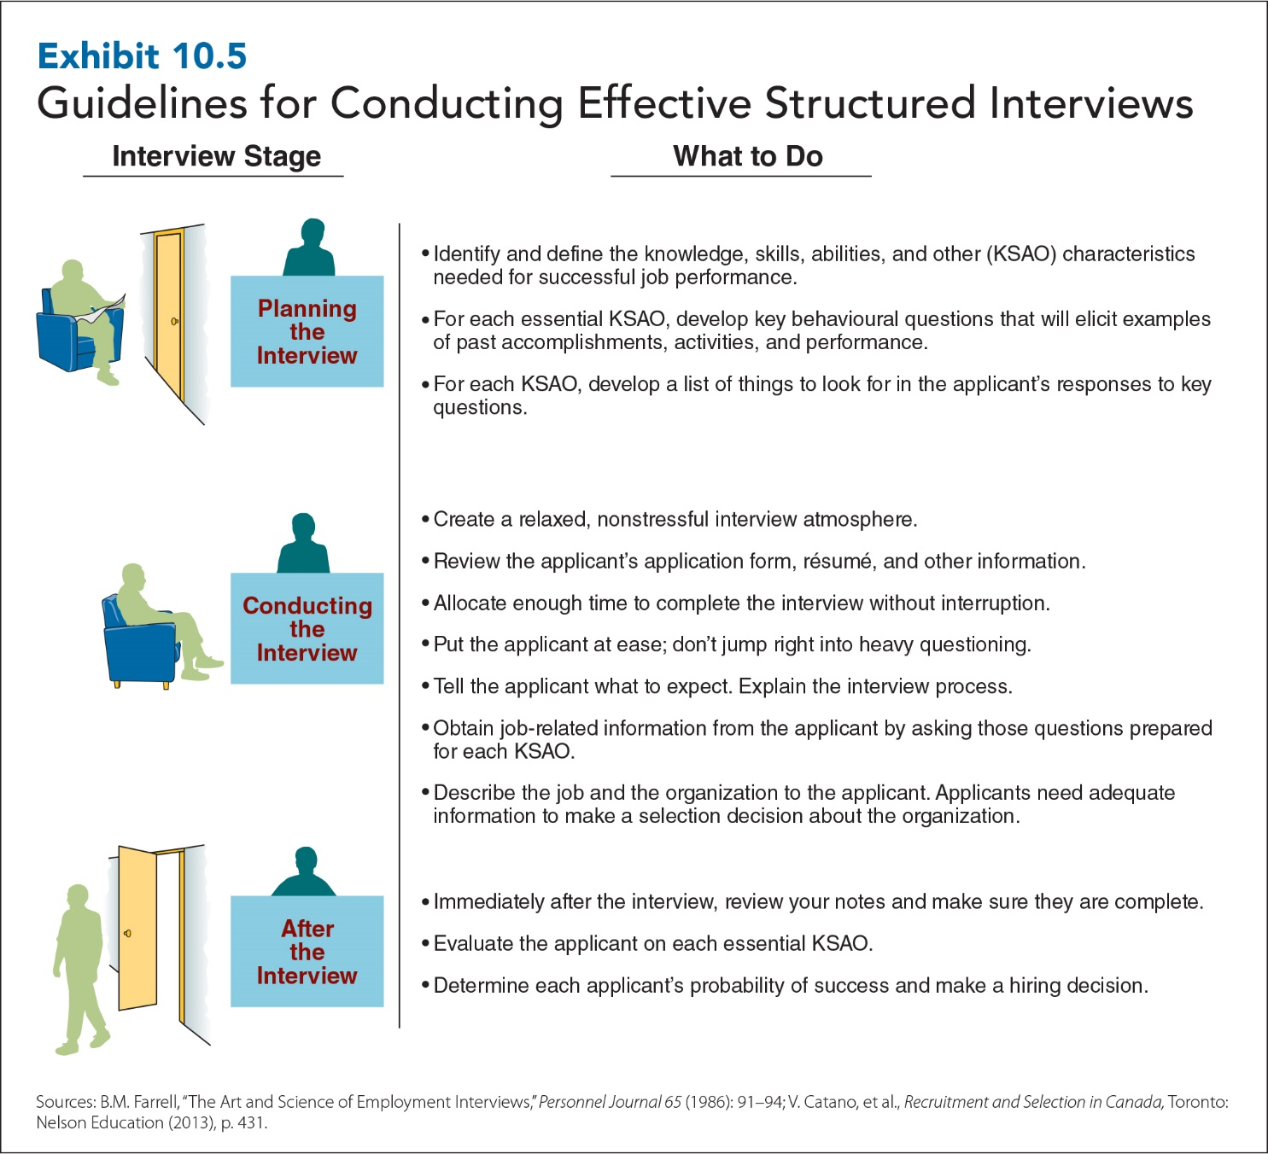
10-30

Slide 24
Common Rating Errors
Central tendency
All workers are rated as being “average.”
Halo error
All workers are rated as performing at the same level in all parts of their jobs.
Leniency error
All workers are rated as performing at a high level.
10-24
Notes:
Workers often have strong doubts about the accuracy of their performance appraisals—and they may be right. It’s widely known that assessors are prone to errors when rating worker performance. Three of the most common rater errors are central tendency, halo, and leniency.
Central tendency error occurs when assessors rate all workers as average or in the middle of the scale.
Halo error occurs when assessors rate all workers as performing at the same level (good, bad, average) in all parts of their jobs.
Leniency error occurs when assessors rate all workers as performing particularly well.
One of the reasons why managers make errors is that they often don't spend enough time gathering and reviewing performance data.

Slide 25
Sharing Performance
Feedback
360-Degree Feedback
Used to overcome the inherent difficulties in performance feedback sessions
Feedback comes from four sources: boss, subordinates, peers and coworkers, and the employees themselves
Feedback compiled and compared against employee's self-ratings
10-25
Notes:
After gathering accurate performance data, the next step is to share performance feedback with employees. Even when performance appraisal ratings are accurate, the appraisal process often breaks down at the feedback stage. Employees become defensive and dislike hearing any negative assessments of their work, no matter how small. Managers become defensive and dislike giving appraisal feedback as much as employees dislike receiving it.
Since performance appraisal ratings have traditionally been the judgments of just one person—the boss—one possibility is to use 360-degree feedback. In this approach, feedback comes from four sources: the boss, subordinates, peers and coworkers, and the employees themselves. The data, which are obtained anonymously (except for the feedback from the boss), are compiled into a feedback report that compares the employee’s self-ratings with those of the boss, subordinates, peers, and coworkers.
About half of the companies using 360-degree feedback for performance appraisal now use feedback only for developmental purposes. Studies clearly show ratees prefer to receive feedback from multiple raters, so 360-degree feedback is likely to continue to grow in popularity.
The 360-degree feedback system has some challenges, however: It was found that sometimes with raises and promotions on the line, peers and subordinates would distort ratings to harm competitors or to help people they liked, and sometimes people would give high ratings in order to get high ratings from others.

Slide 26
Compensation
3 basic kinds of compensation decisions:
Pay level (job evaluation)
Determines market value and worth of the job
Pay variability
Piecework, commission, profit sharing, employee stock ownership plans, stock options
Pay structure
Hierarchical or compressed
26
10-26
Notes:
Compensation: includes both the financial and non-financial rewards that organizations give employees in exchange for work (often referred to as total rewards)
1) Pay-level decisions are decisions about whether to pay workers at a level that is below, above, or at current market wages. Companies use job evaluation to set their pay structures. Job evaluation: a process that determines the worth of each job in a company by evaluating the market value of the knowledge, skills, and requirements needed to perform it.
Above-market wages can attract a larger, more qualified pool of job applicants, increase the rate of job acceptance, decrease the time it takes to fill positions, and increase the time that employees stay.
Foreign workers in many parts of the world end up in low-paying jobs that disappear at the whim of the employer, with little in the way of security or benefits. Canada has a Seasonal Agricultural Workers Program that is considered by many a model of well-managed temporary immigration. In the European Union, a third-country national (someone from outside the EU) who has held a legal temporary position for five years is entitled to permanent residency.
2) Pay-variability decisions concern the extent to which employees’ pay varies with individual and organizational performance. Linking pay to organizational performance is intended to increase employee motivation, effort, job performance.
Piecework: a compensation system in which employees are paid a set rate for each item they produce (e.g., $0.35 per item produced for an output of up to 100 units/day). Once productivity exceeds the standard, employees are paid a set amount for each unit of output over the standard (e.g., $0.45 for each unit above 100 units).
Sales commission: a compensation system in which employees earn a percentage of each sale they make. The more they sell, the more they earn.
Profit sharing: a compensation system in which a company pays a percentage of its profits to employees in addition to their regular compensation. The more profitable the company, the more profit is shared.
Employee stock ownership plans (ESOPs): a compensation system that awards employees shares of company stock in addition to their regular compensation.
Stock options: a compensation system that gives employees the right to purchase shares of stock at a set price, even if the value of the stock increases above that price (e.g., if you’re awarded the right/option to 100 shares of stock valued at $5/share and stock price rises $15/share, you can exercise your options and make $1000 [100 shares that have increased $10 in value, from $5 to $15]). As the company profits and share values increase, stock options become more valuable to employees.
2) Pay structure decisions are concerned with internal pay distributions, meaning the extent to which people in a company receive different levels of pay. With hierarchical pay structures, big differences from one pay level to another exist. The largest pay levels are for people near the top of the pay distribution. The idea behind hierarchical pay structures is that large differences in pay between jobs or organizational levels should motivate people to work harder to obtain higher-paying jobs.
With compressed pay structures, there are fewer pay levels and smaller differences in pay between pay levels. Pay is less dispersed and more similar across jobs in company. The idea behind compressed pay structures is similar: pay levels lead to higher levels of cooperation, feelings of fairness and common purpose, and better group and team performance.
Hierarchical pay structures work best when clear links can be drawn between individual performance and individual rewards. By contrast, compressed pay structures, in which everyone receives similar pay, seem to work best for work that requires employees to work together. Some companies are pursuing a middle ground, combining hierarchical and compressed pay structures by giving ordinary workers the chance to earn more through ESOPs, stock options, and profit sharing.

